Slide 1
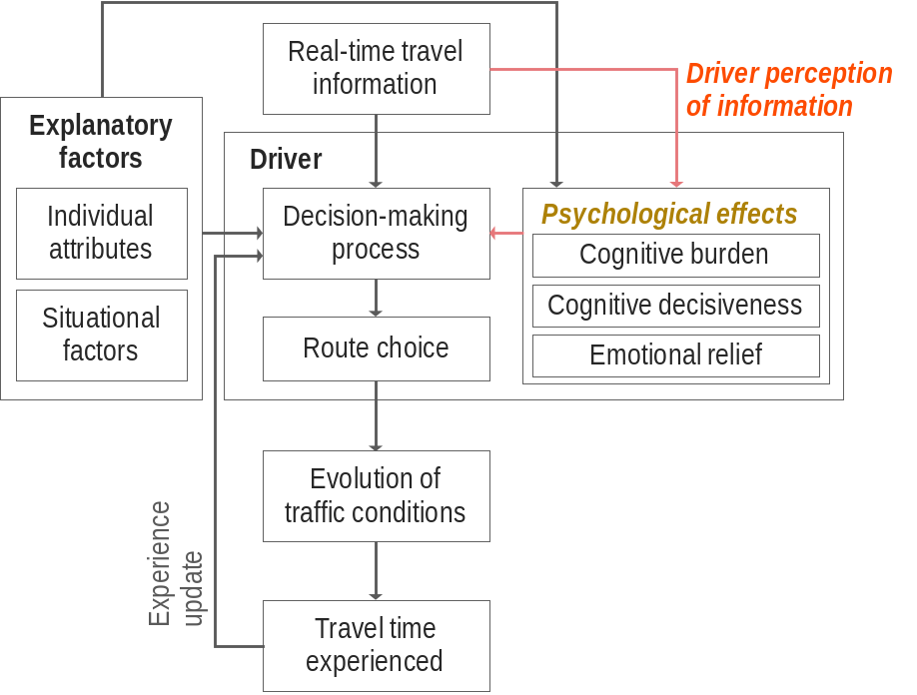
Psychological Effects of Real-Time Travel Information on
Traveler Route Choice Decision-Making Process
Dongyoon Song, Srinivas Peeta, Yu-Ting Hsu
Paper # 17-01162, Session 459, MON 3:45pm
Motivation
Role of human factors in information perception
Role of perceived information in route choice decision-making
Psychological effects
Cognitive burden
  Amount of mental effort required to process information-related cues
Cognitive decisiveness
  Level of awareness in comprehending the travel situation and level of uncertainty reduction in making decisions
Emotional relief
  Level of mental relief due to the anticipation of future outcomes

Slide 2
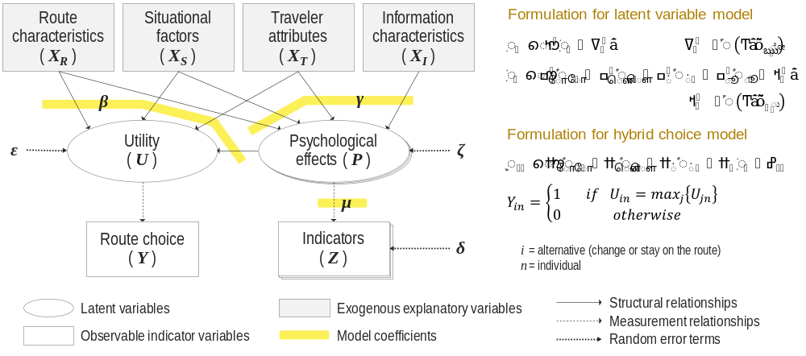
Psychological Effects of Real-Time Travel Information on
Traveler Route Choice Decision-Making Process
Dongyoon Song, Srinivas Peeta, Yu-Ting Hsu
Paper # 17-01162, Session 459, MON 3:45pm
Key findings
Stress from information overload or information-induced confusion can weaken the influence of information on travelers.
Reduced uncertainty leads to higher willingness to take risk of route switch.
Favorable information increases the route propensity to change the route.

